Slide 1
SPECIAL VARIABLES GROUP B
NANDHA KUMAR PT
MANTHARAGIRI M
VEERA VENKATA VASANTHA RAYULU BUGIDE
SIRISHA NB

Slide 2
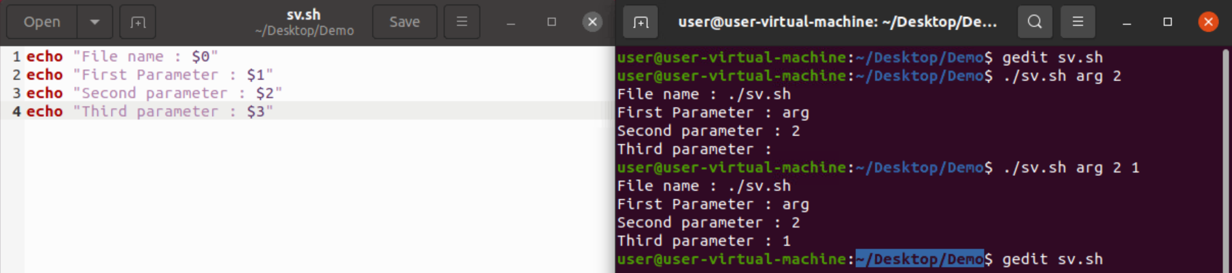
Special variables in shell scripting
1) $0 :- This special variable is used to show the file name of the shell.
2) $1 and $2 :- $1 and $2 is used to show the arguments which u have passed to shell.

Slide 3
$# and $$
$#-The number of arguments supplied to a script.
$$-The process ID of the current shell.

Slide 4
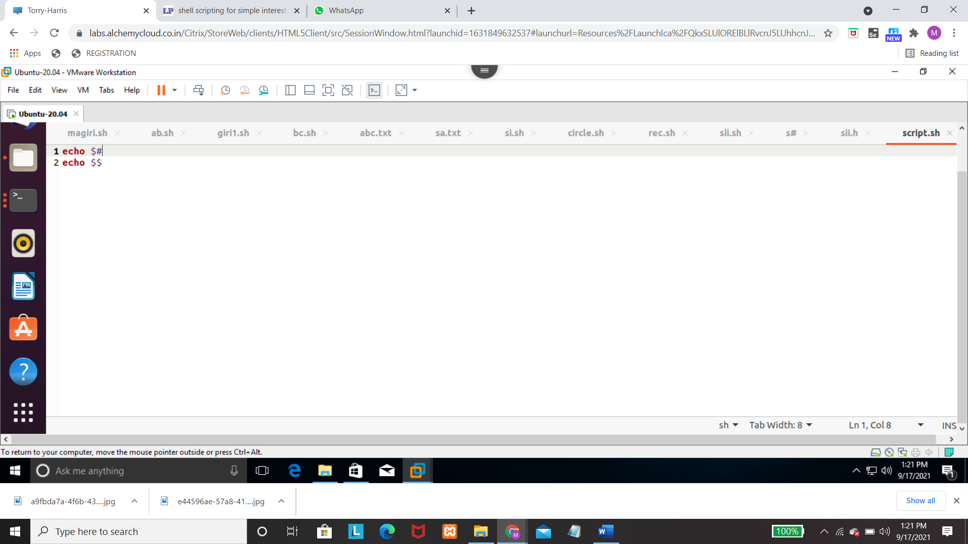

Slide 5
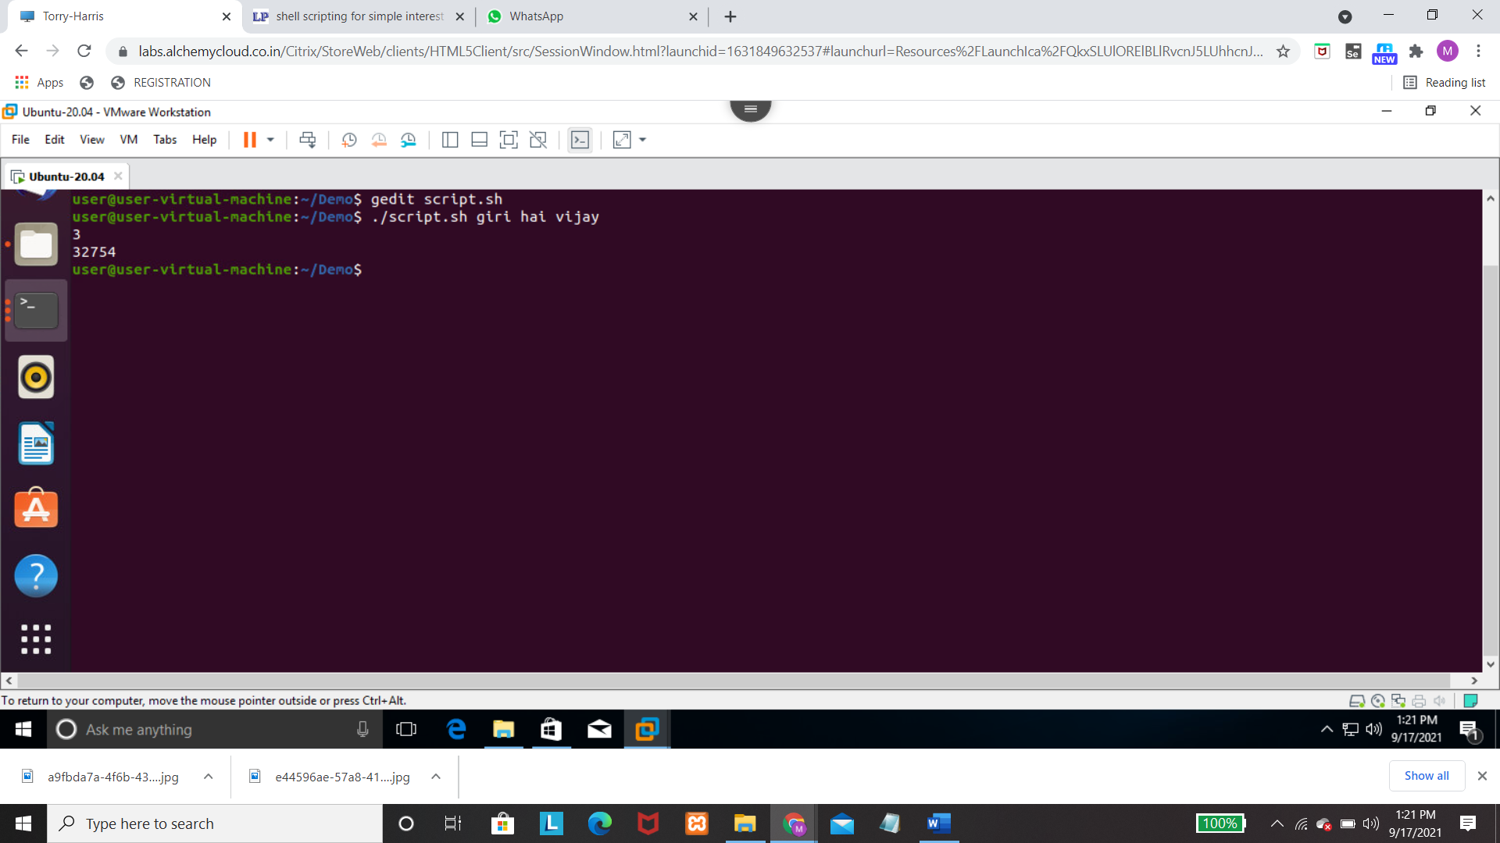

Slide 6
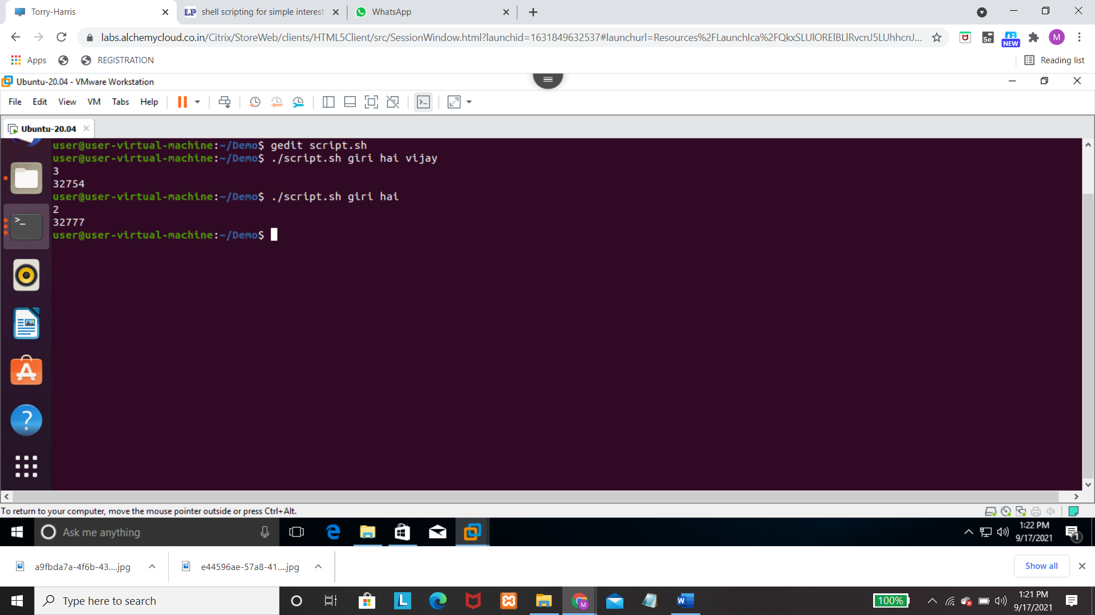

Slide 7
$* and $@
$* -> it stores the complete set of positional parameters as a single string
$@ -> each quoted string treated as a separate argument

Slide 8
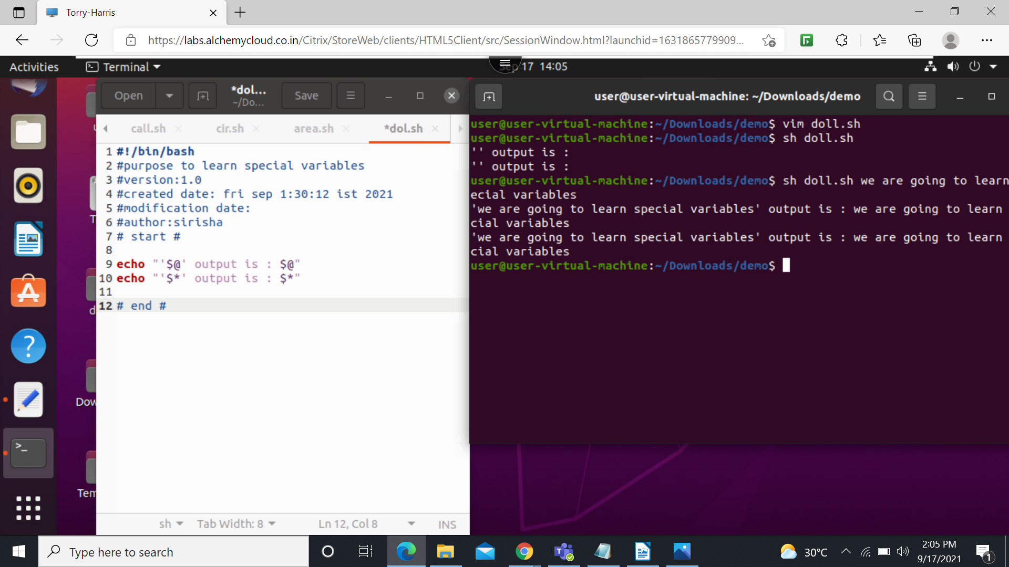

Slide 9
$? AND $!
$? Shows the status of the last command executed
0 – succesfull execution
1-unsucessfull execution
$! PID of the last program shell ran in the background.

Slide 10
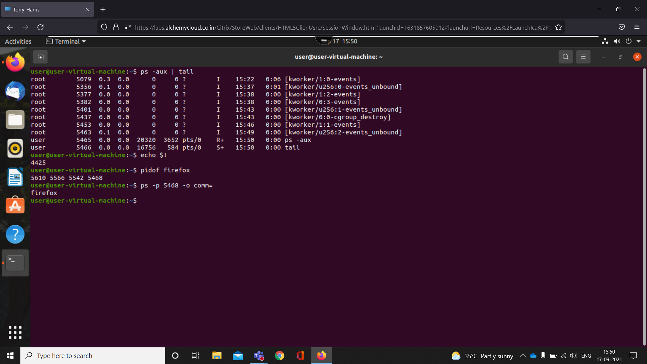

Slide 11
